Slide 1
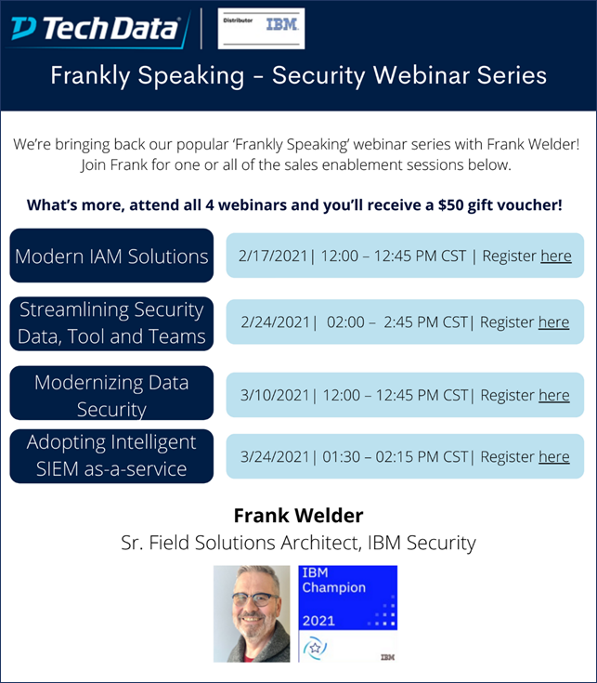
Can Your SEIM See
Through the Clouds?
Ours Has Perfect Vision
24 March 2021

Slide 2
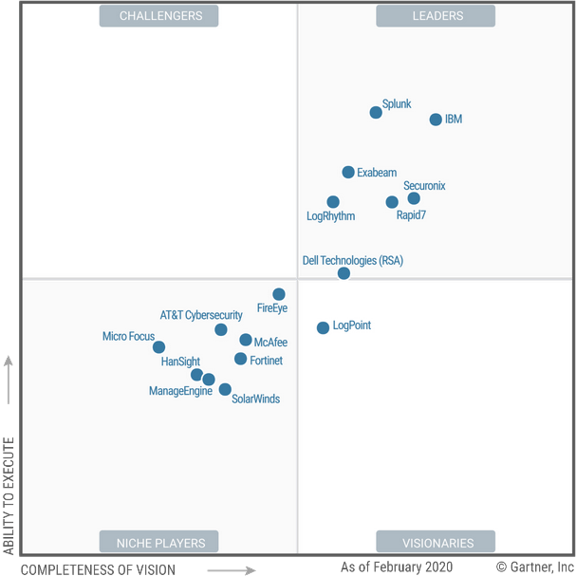
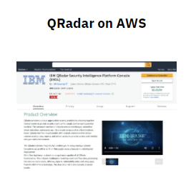
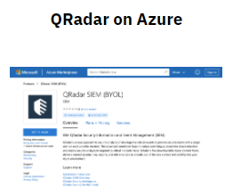
Yes – QRadar – Market Leader 11 Years in a Row!
IBM
The QRadar Security Intelligence Platform is primarily built around the QRadar SIEM solution and composed of several other separately priced components:
IBM QRadar Network Insights — QNI application visibility and packet content inspection
IBM QRadar User Behavior Analytics (UBA) — a free add-on module that addresses some insider threat use cases
IBM QRadar Advisor with Watson — advanced-analytics-based root cause identification and attribution engine
IBM QRadar SIEM can be deployed on-premises, via hardware virtual appliances and software packages, or it can be hosted in the cloud via IBM’s cloud-based SIEM solution, QRadar on Cloud (QROC).
Get the Report! No Charge from Gartner Click Here

Slide 3
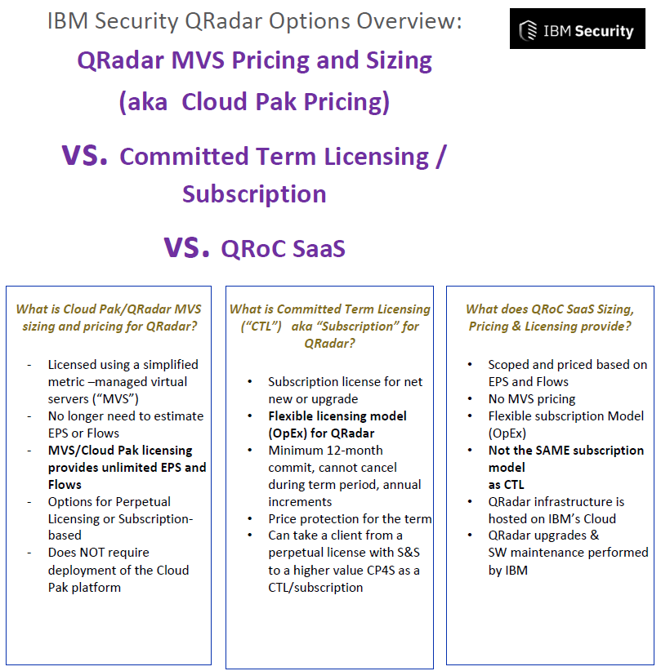
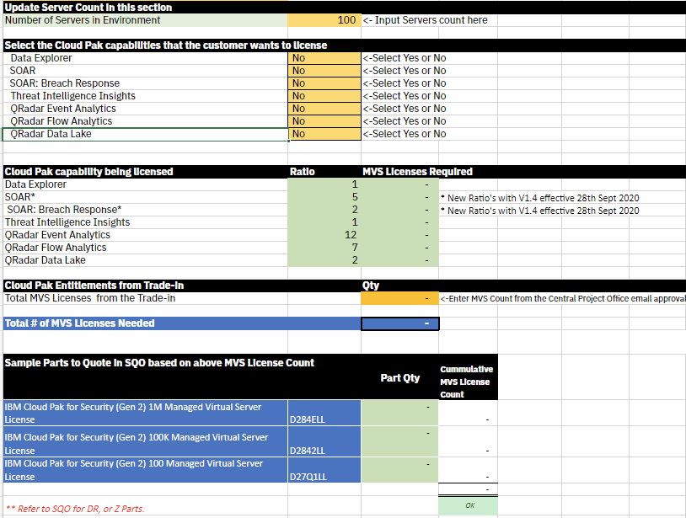
Just a Refresher – The Many Ways to Purchase QRadar (Thanks IBM)

Slide 4
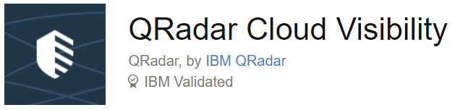
Let’s Talk a BUNCH more about “Cloud Vision”
Read All About It!
(Click Me)
QRadar Cloud Visibility is a multi-cloud solution to manage and provide security for Amazon Web Services, Microsoft Azure, Google Cloud and IBM Cloud environments.
The app leverages existing QRadar cloud integrations that bring log data from Infrastructure as a Service (IaaS) environments into QRadar, and utilizes rules from QRadar's cloud content extensions in the IBM Security App Exchange. Using these data streams and security use cases, QRadar can detect cloud misconfigurations (such as those common in AWS S3 buckets or Azure Blob storage) and identify threats.
The Cloud Visibility app enables analysts to visualize potential offenses in AWS, Microsoft Azure, and IBM Cloud.

Slide 5
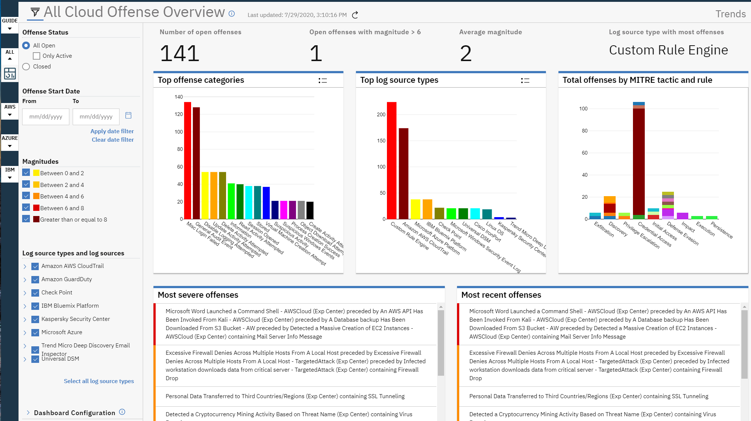
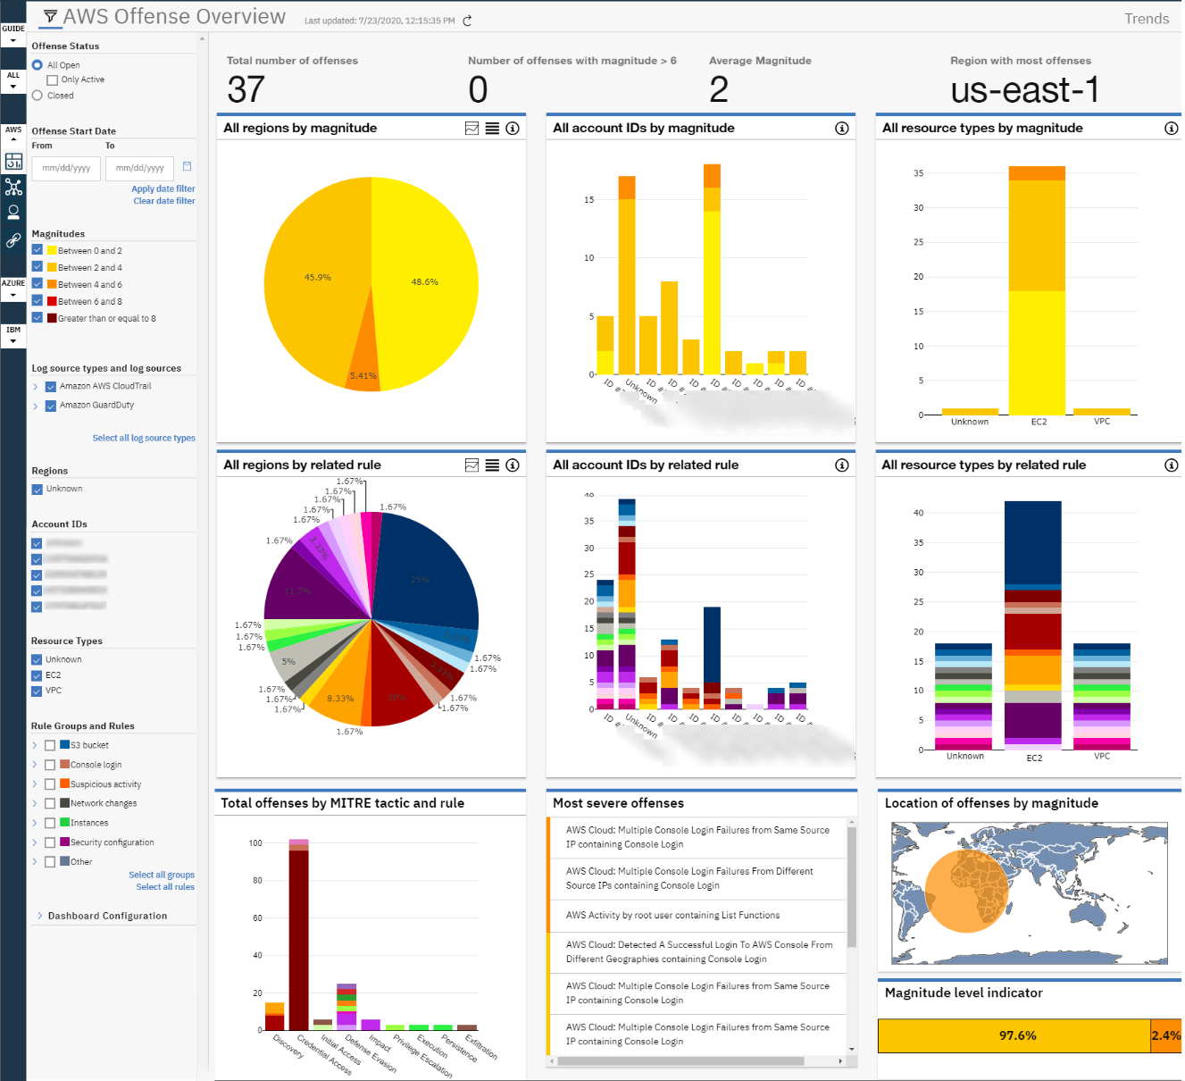
All Your Clouds In One Place – PERFECT Visibility!

Slide 6
Cloud Integrations Supported by QRadar
AWS
Microsoft
IBM Cloud
Google
Log source type | Supported Function
CloudTrail | Amazon AWS S3 REST API Protocol Amazon AWS CloudTrail
GuardDuty | Amazon Web Services Protocol Amazon GuardDuty
VPC Flow Logs | Amazon AWS S3 REST API Protocol
Security Hub | Amazon Web Services Protocol Amazon AWS Security Hub
Log source type | Supported Function
Microsoft Azure Platform | Microsoft Azure Event Hubs Protocol Microsoft Azure Platform
Microsoft Azure Active Directory | Microsoft Azure Event Hubs Protocol Microsoft Azure Active Directory
Microsoft Azure Security Center | Microsoft Graph Security API Protocol Microsoft Azure Security Center
Log source type | Supported Function
IBM Bluemix Platform | IBM Bluemix Platform
IBM Cloud Identity | IBM Cloud Identity Event Service Protocol IBM Cloud Identity
Log source type | Supported Function
Google Cloud Audit | Google Cloud Pub/Sub Protocol Google Cloud Audit Logs DSM
Google G Suite Activity Reports | Google G Suite Activity Reports REST API Protocol Google G Suite Activity Reports DSM

Slide 7
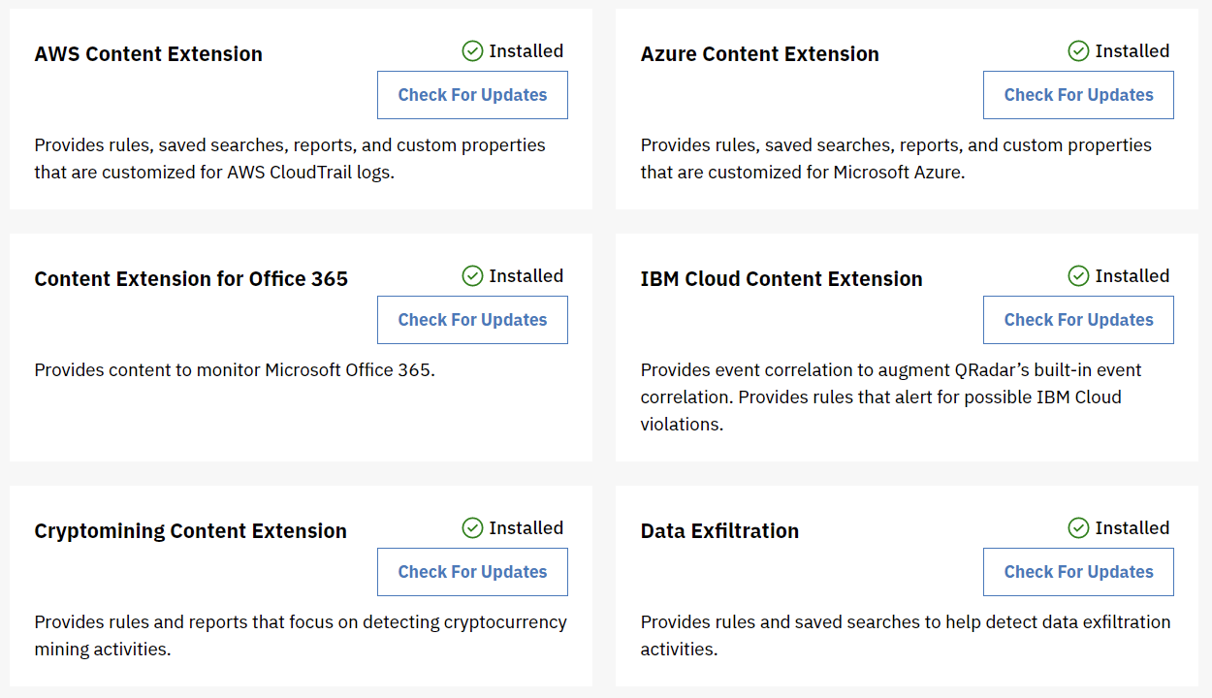
IBM QRadar – Content Extensions – Speaking Your Cloud Language

Slide 8
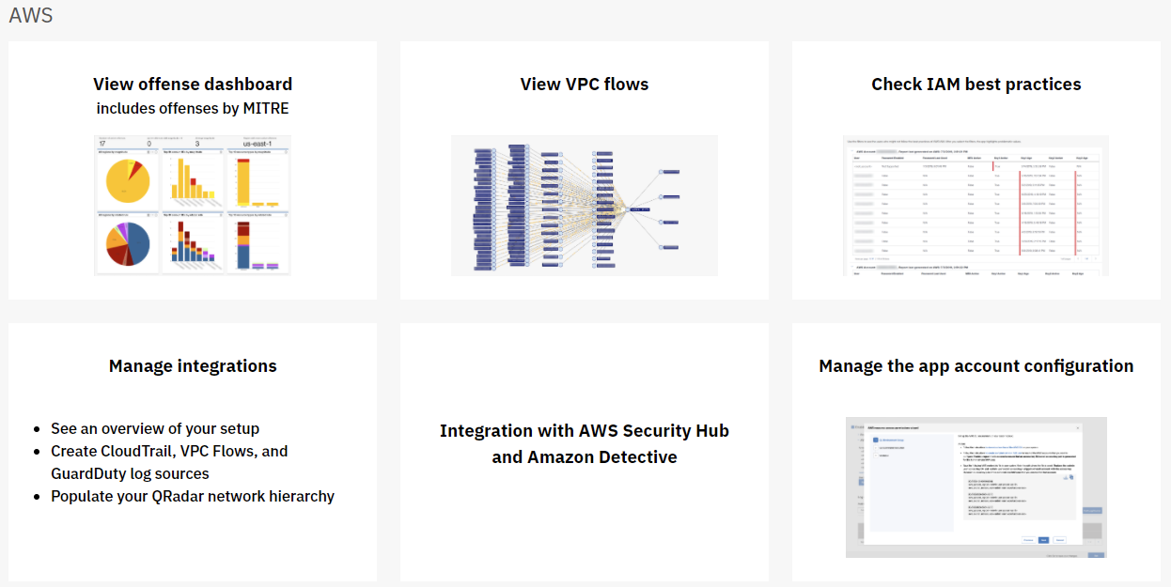
Gain Insights into Your Cloud Environment

Slide 9
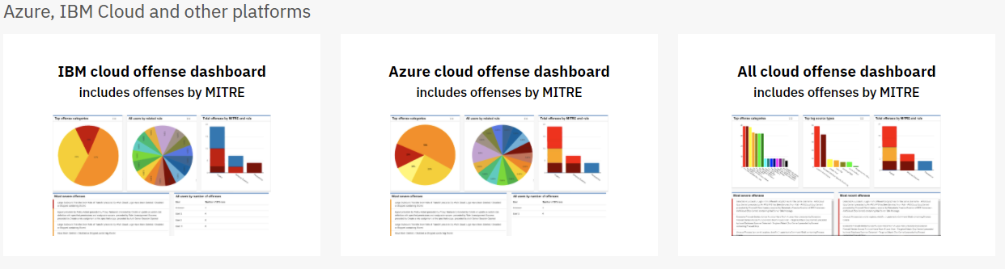
Gain Insights into Your Cloud Environment

Slide 10

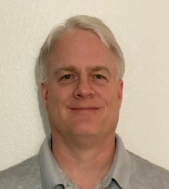


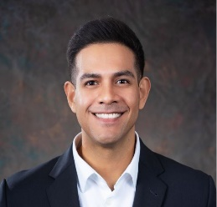
Tech Data - IBM Security Brand Team
Business Development Executive Team Partner Coverage
Karen Bailey
Business Development Executive
Location – Alpharetta, Georgia
(678) 642-3446
karen.bailey@techdata.com
Karen Bailey– East Partner Coverage
Rick Marshall– West Partner Coverage
Rick Marshall
Business Development Executive
Location – Tempe, Arizona
(480) 254-4420
Rick.Marshall@Techdata.com
Frank Welder
Sr. Field Solutions Architect
Location – United States
(317) 883-9353
frank.welder@techdata.com
John Garrett
IBM Public Sector Specialist
Location – Fairfax, VA
(571) 217-7102
john.garrett@techdata.com
Antonio Ruiz
IBM Vendor Business Executive
Location – San Antonio, Texas
(210) 683-2290
antonio.ruiz@techdata.com

Slide 11
Frankly Speaking – Security Webinar Series - Schedule

